Slide 1
GSA: Badge Tracking Application
Team Cookie Council
Matt Eck – Database Manager
Mike Glosecki – Quality Assurance
Nathan Martz – Customer Proxy
Ryan Schroeder – Scrum Master

Slide 2
Genesis: Inspiration / Motivation
Context:
Girl Scout Leader Troop Management
Problem:
Current paper record keeping system is inefficient
Concept:
Develop a web based application which will automate some of these processes and make the information more manageable

Slide 3
Client’s Needs
Application to manage troop records.
Badges, Journeys, Awards, and Bridging overview and updates
Individual Scout Records tracking
Event Tracking
Financial Tracking
Shopping List Creation

Slide 4
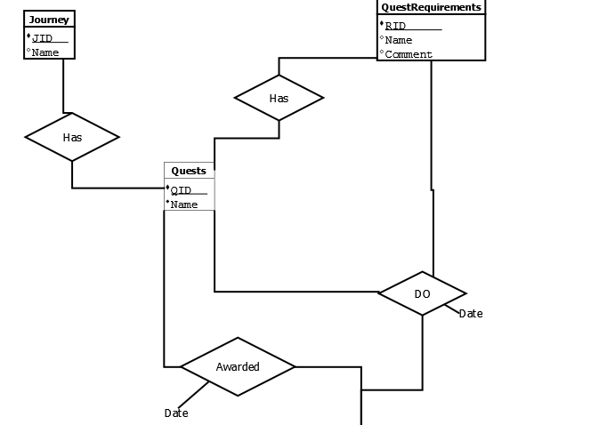
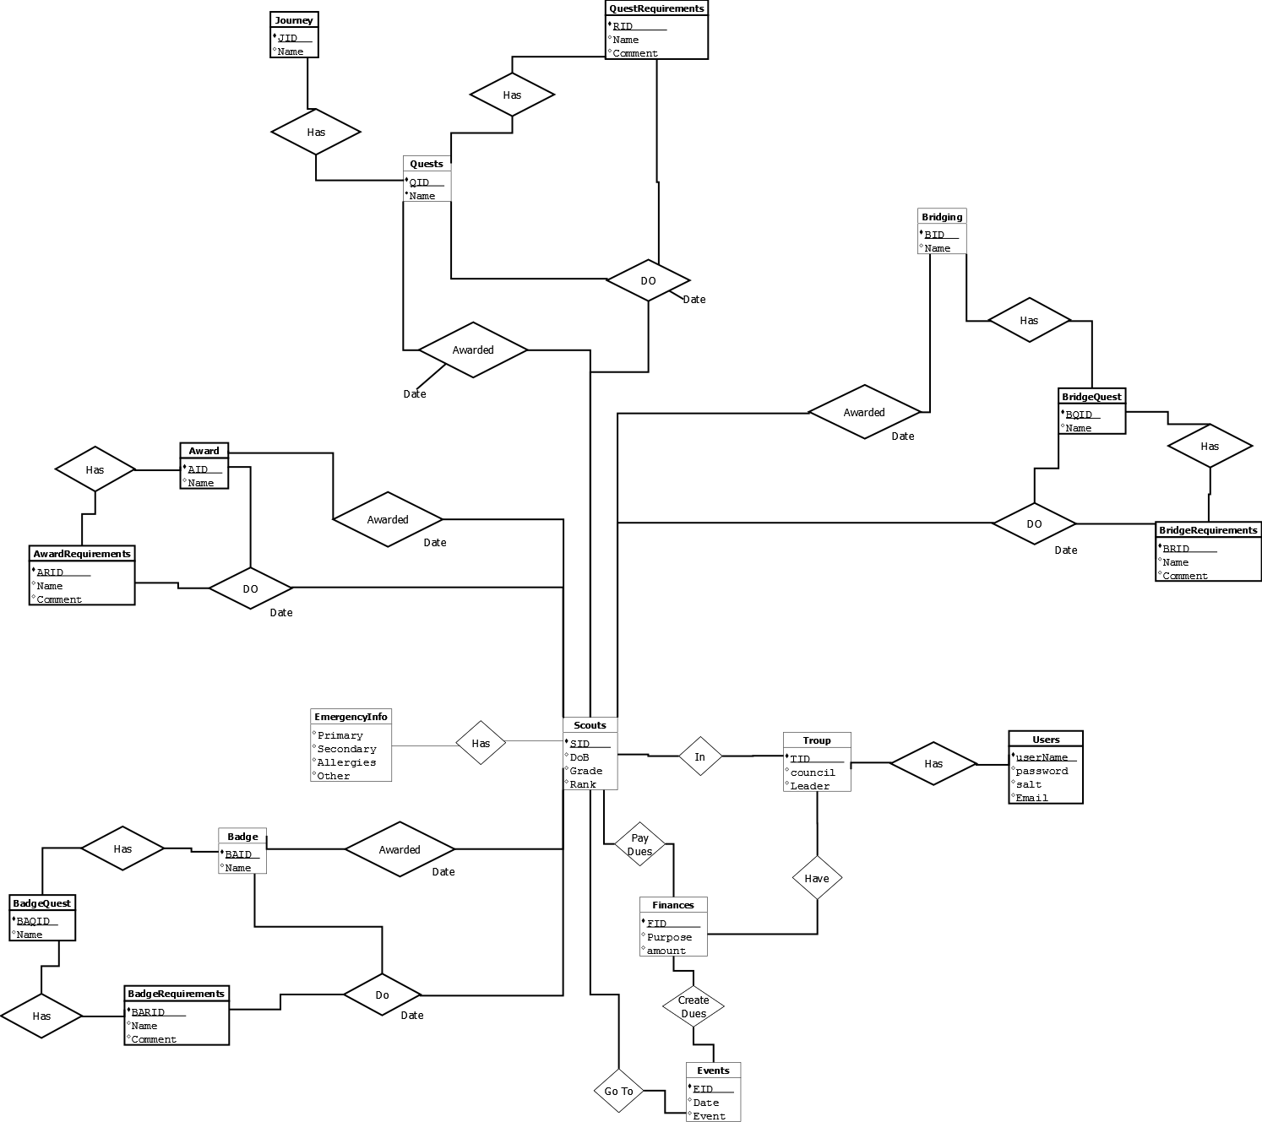
Entity Relationship Diagram

Slide 5
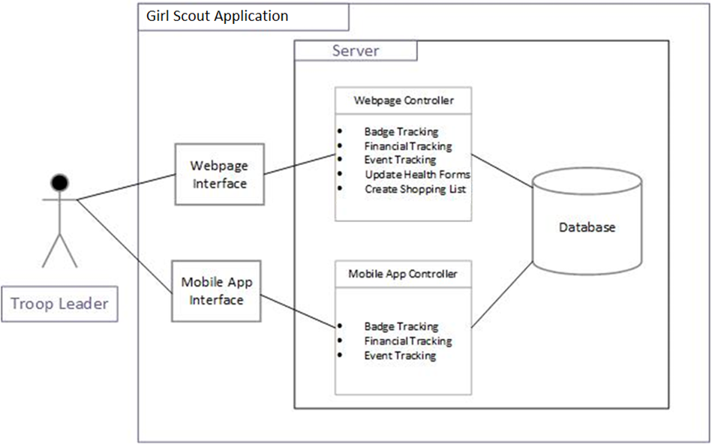

Slide 6







Product Capabilities
Full implementation of all client specifications:
Badges, Journeys, Awards, and Bridging overview and updates
Individual Scout Records tracking
Event Tracking
Financial Tracking
Shopping List Creation
Technologies Used

Slide 7
Testing
Behavioral Driven Development
Went through scenarios - checked for expected results.
Unit Testing
Tested individual pages and functions
Usability Testing
Shown to outside sources and took input on appearance and functionality
Integration Testing
All pages were properly linked and working together

Slide 8
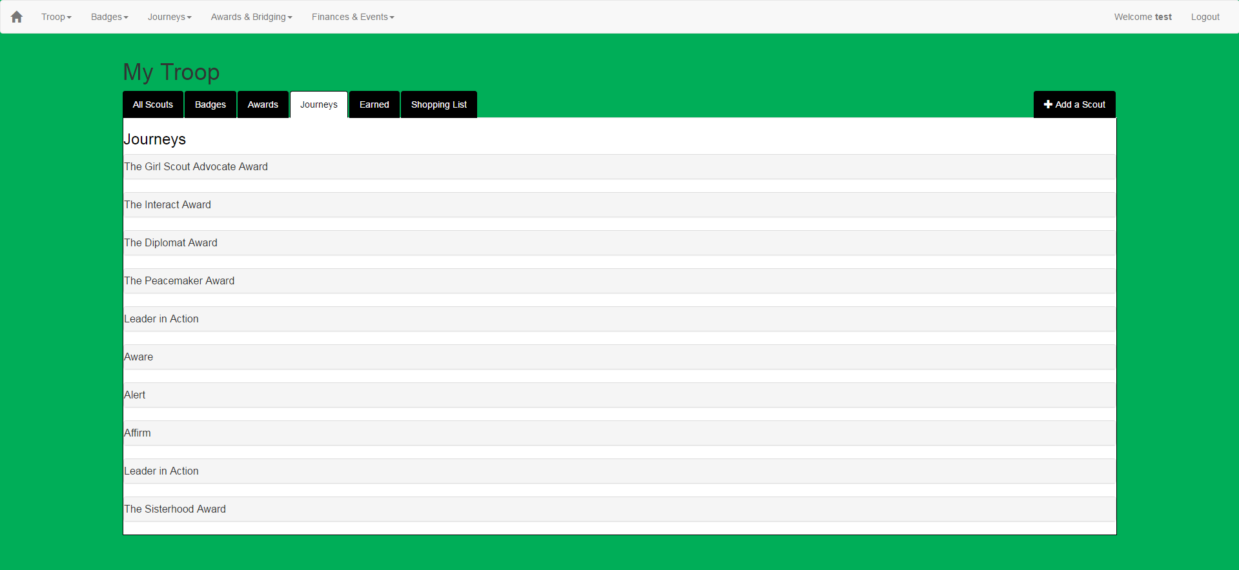
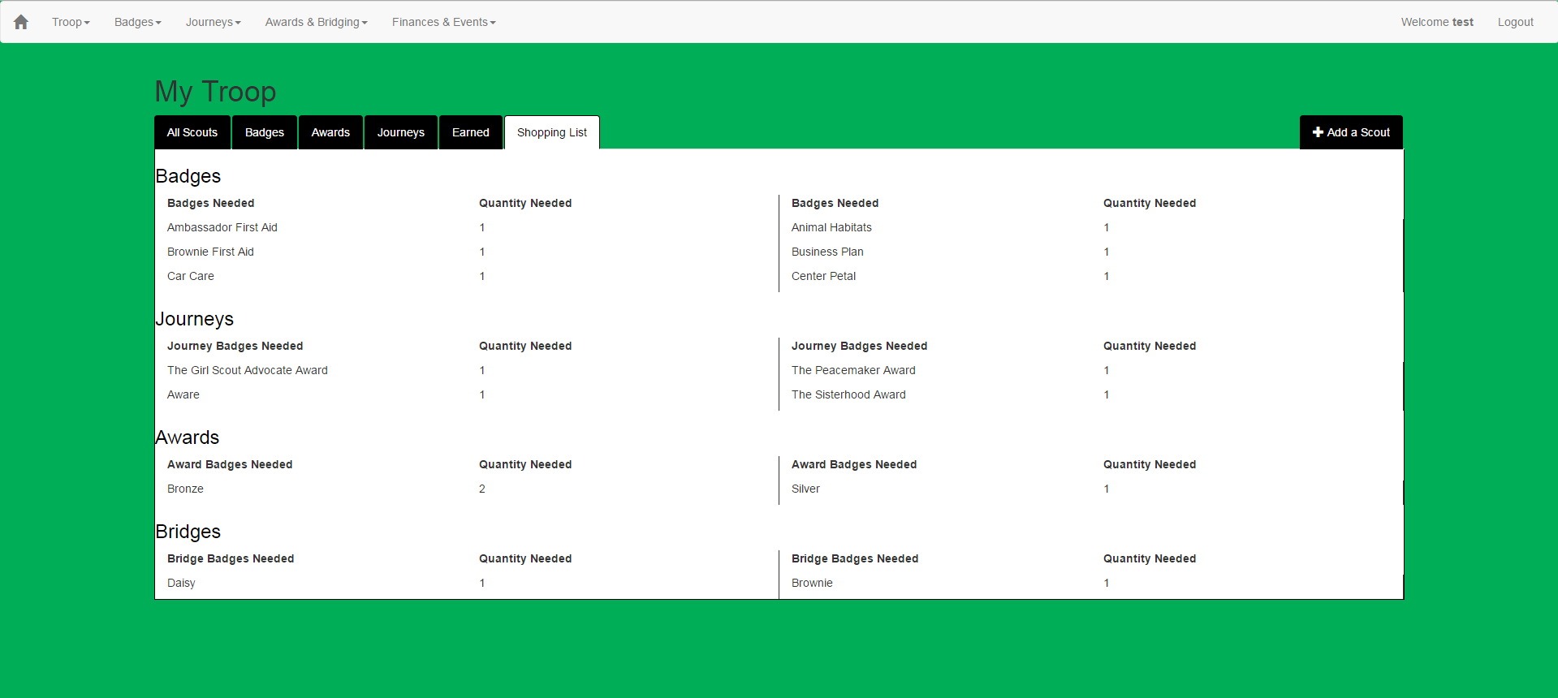
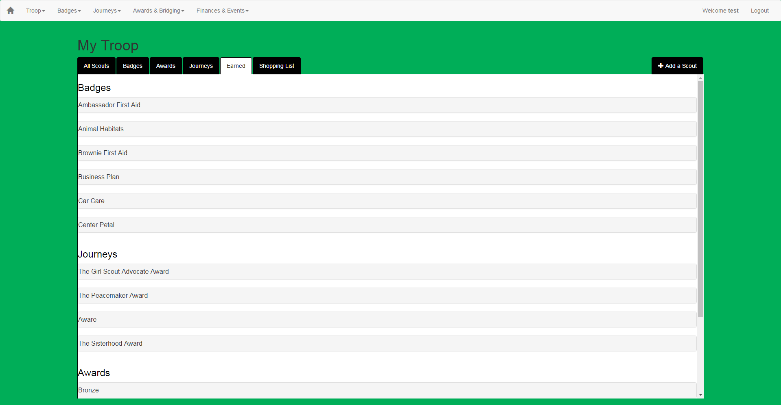
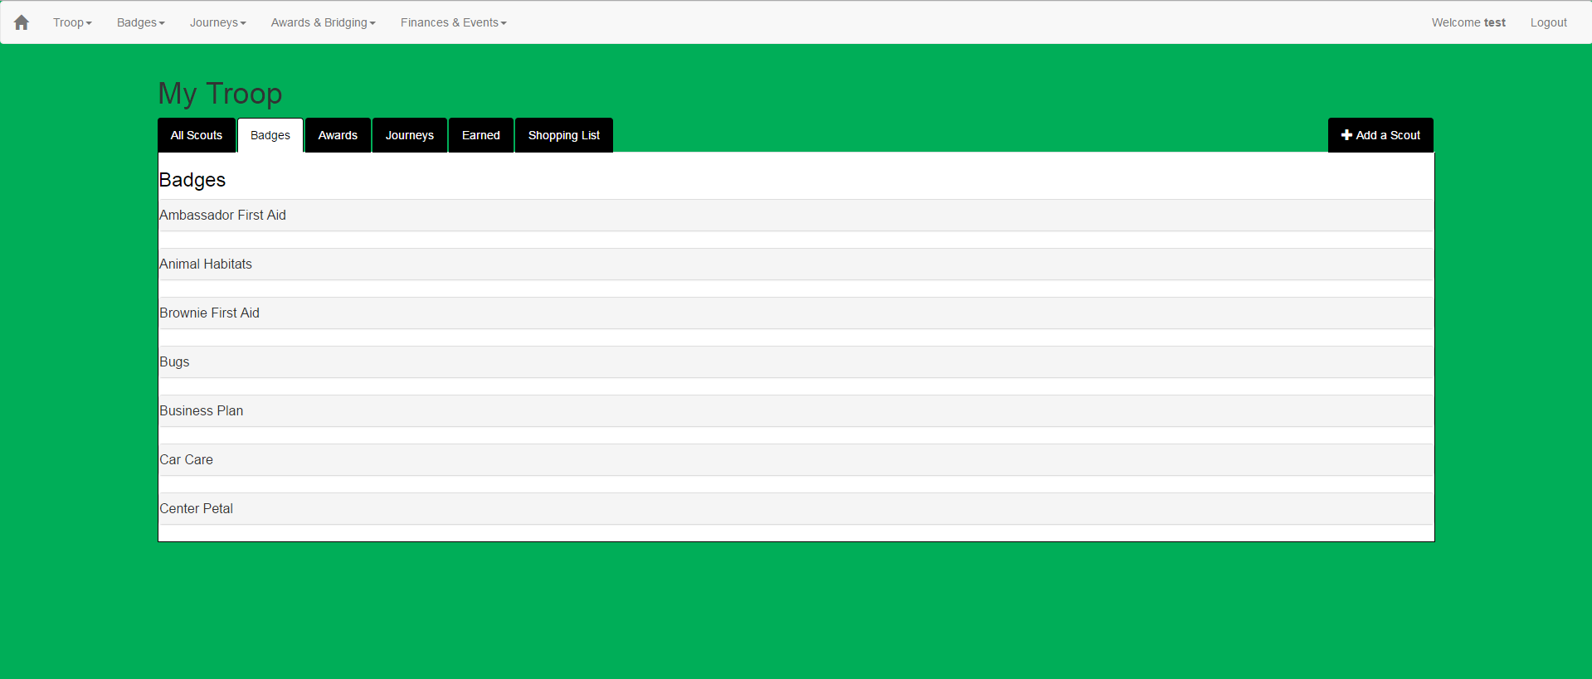
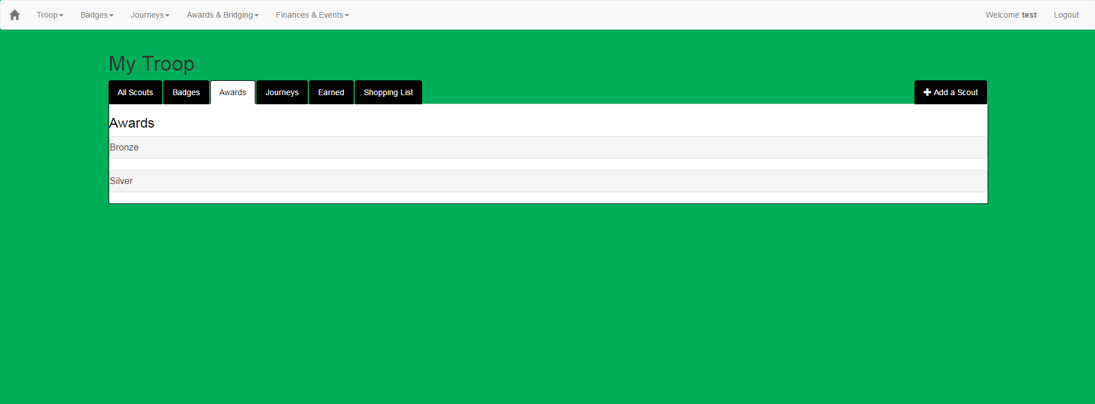
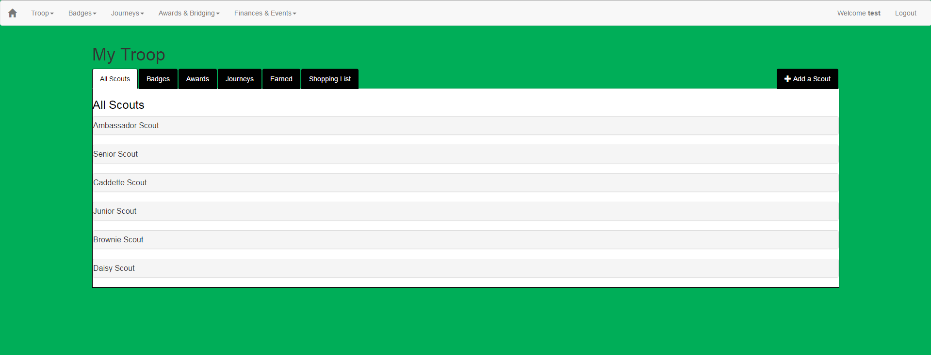

Slide 9
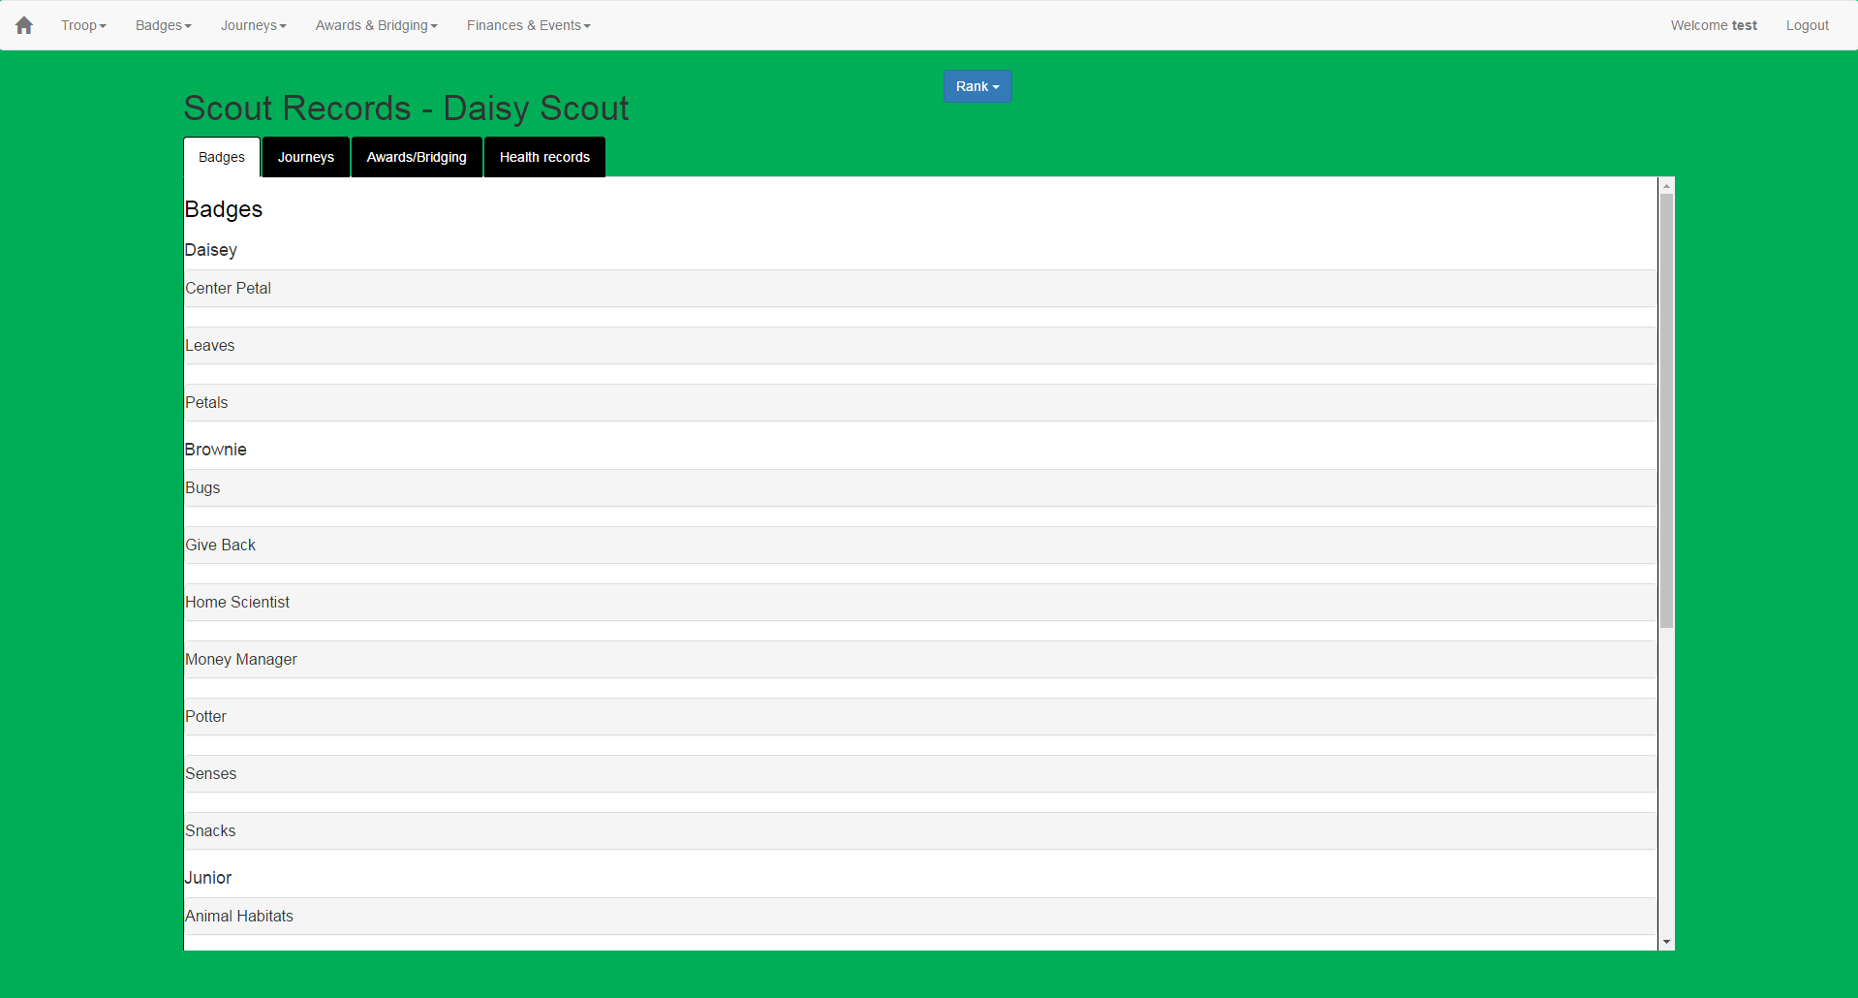
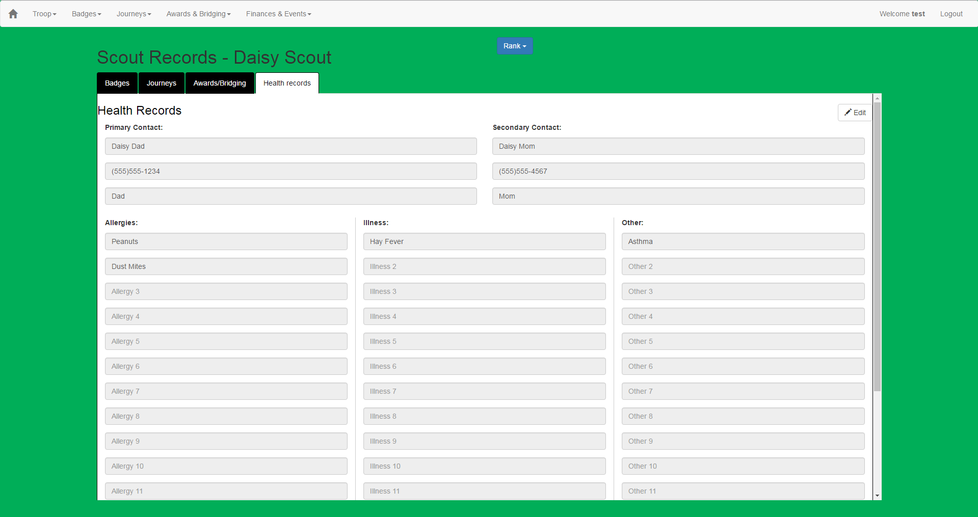
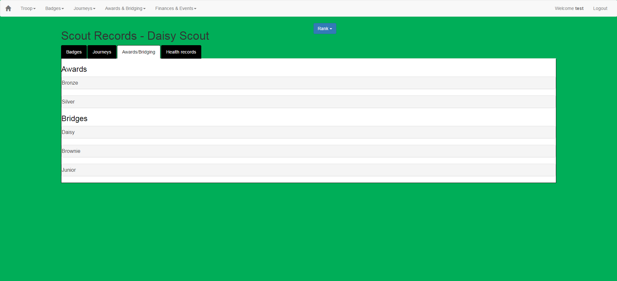
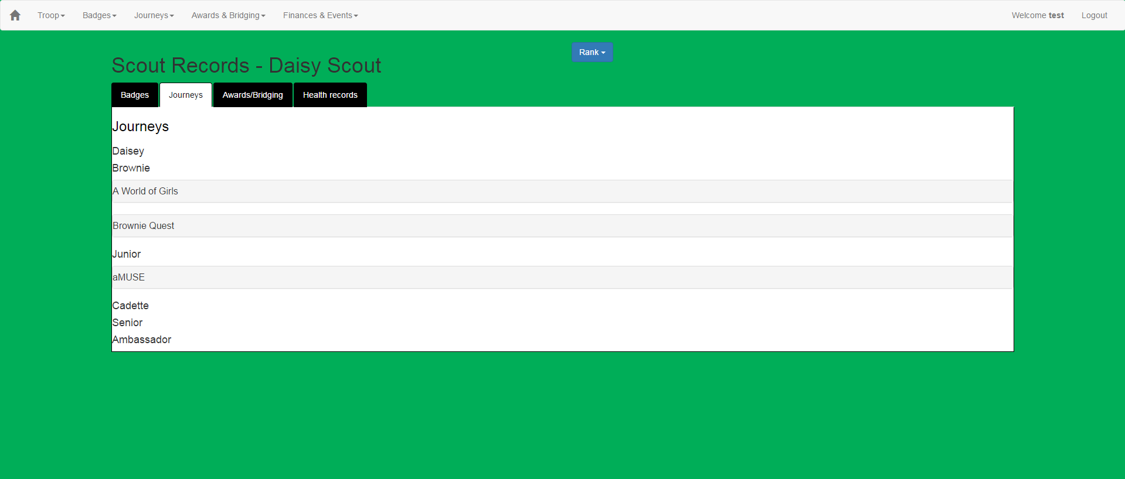

Slide 10
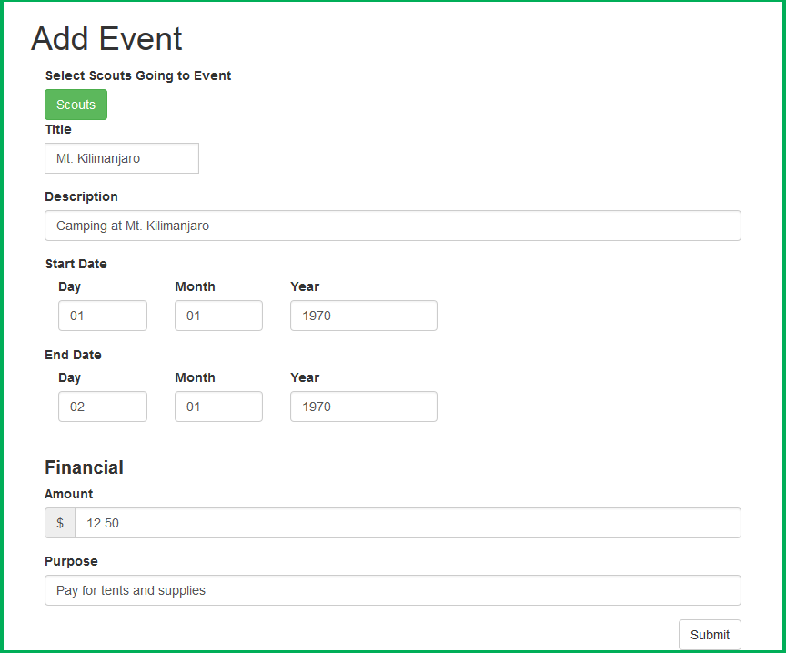

Slide 11
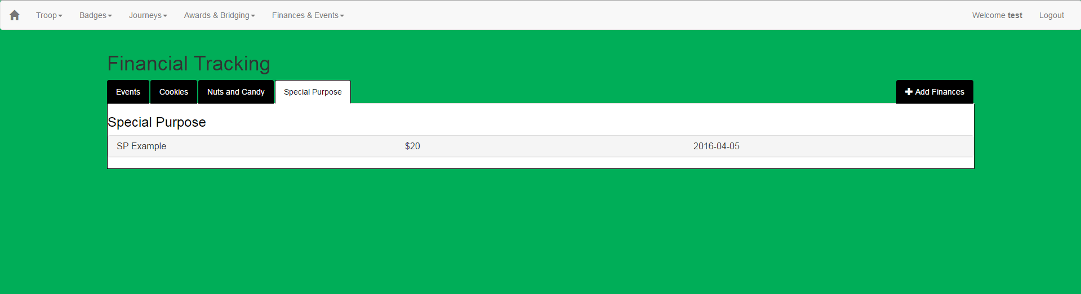
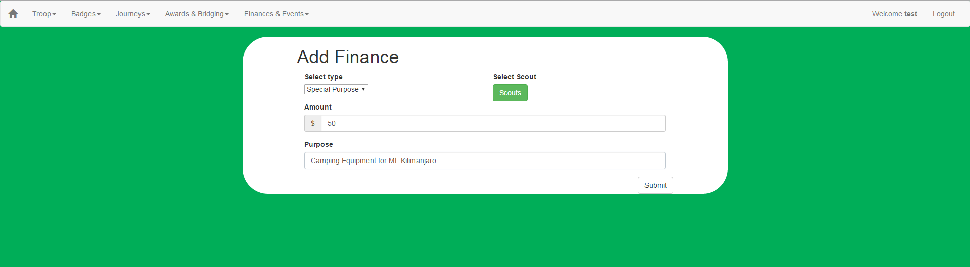
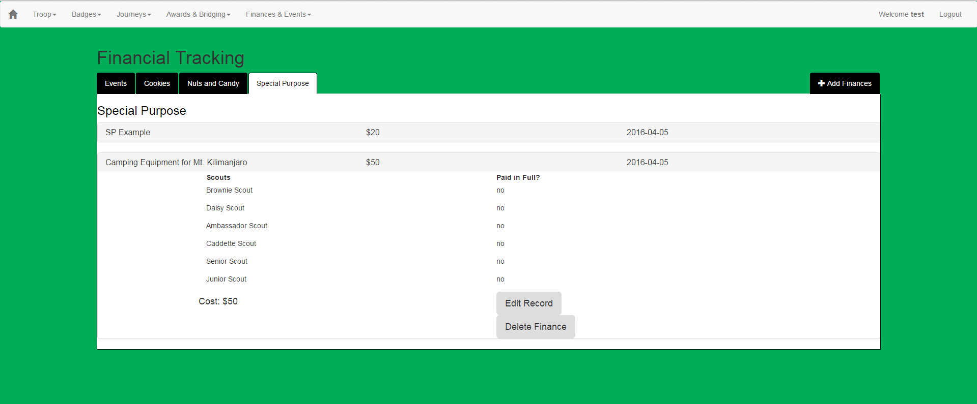
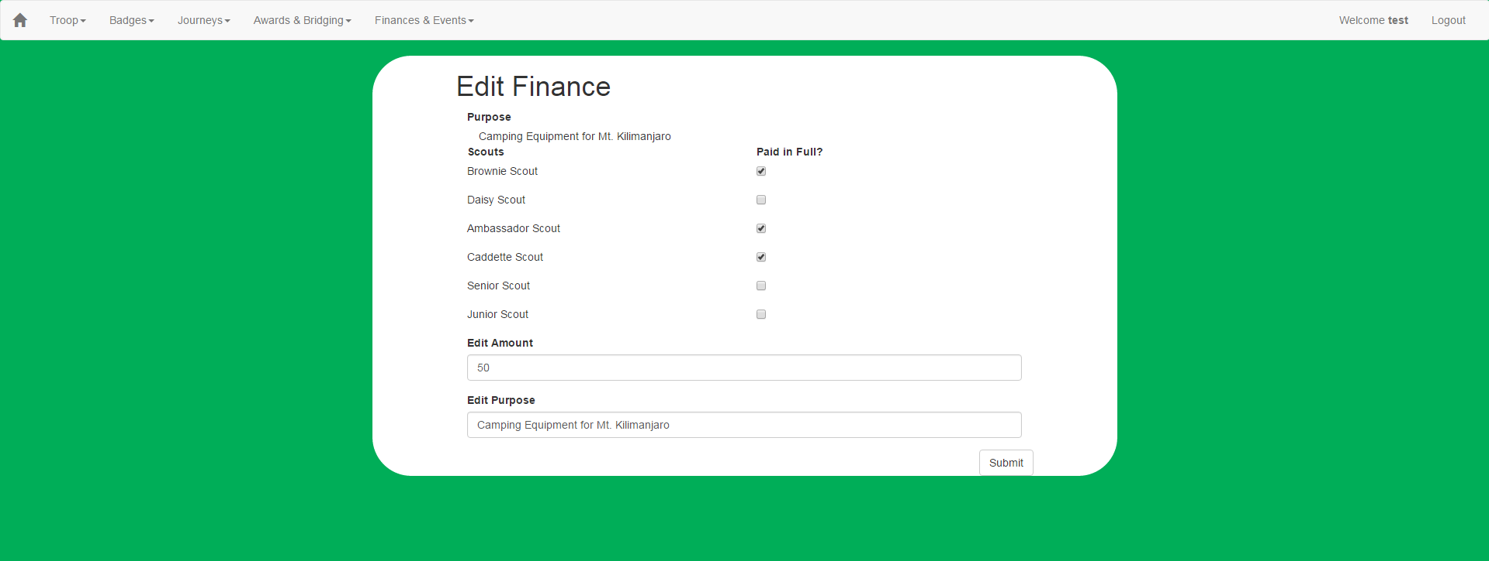
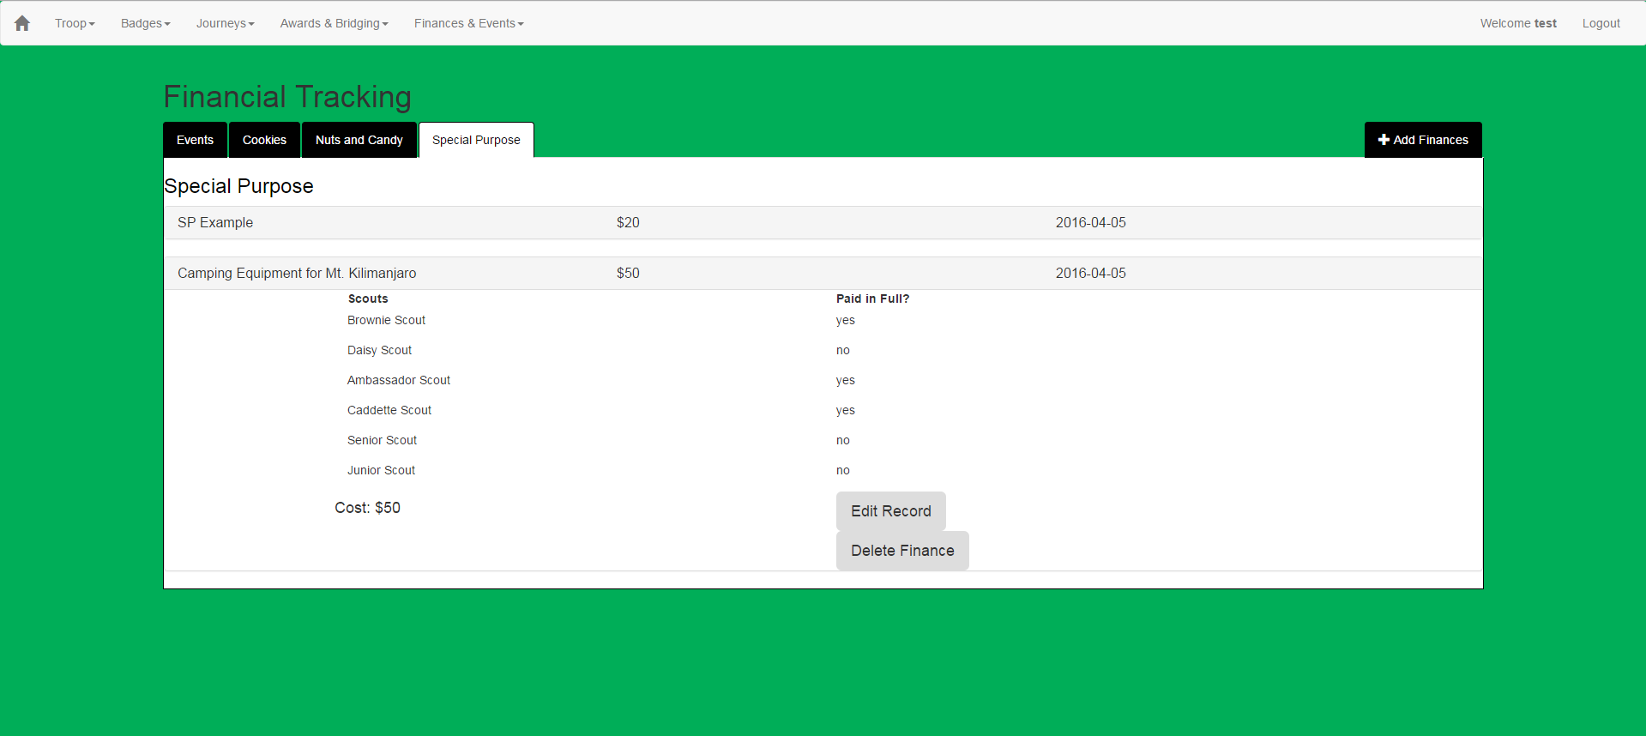

Slide 12
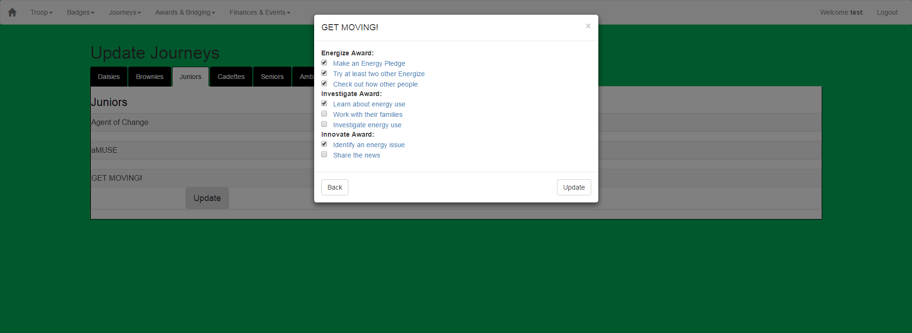
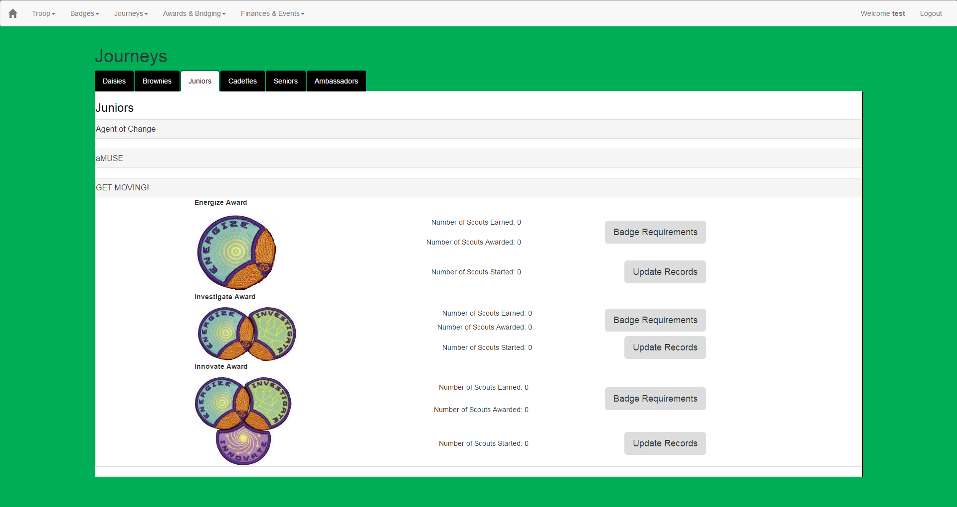
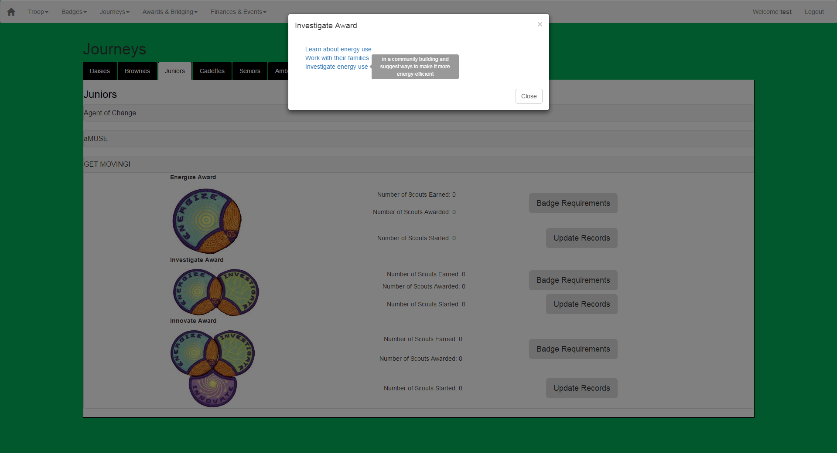
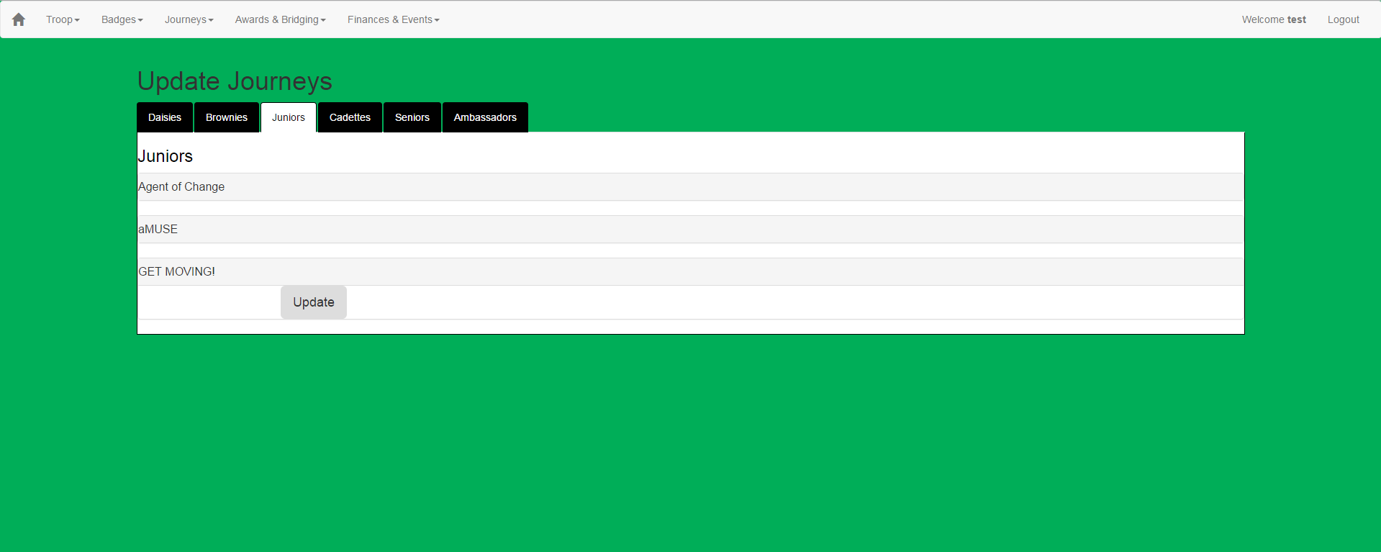
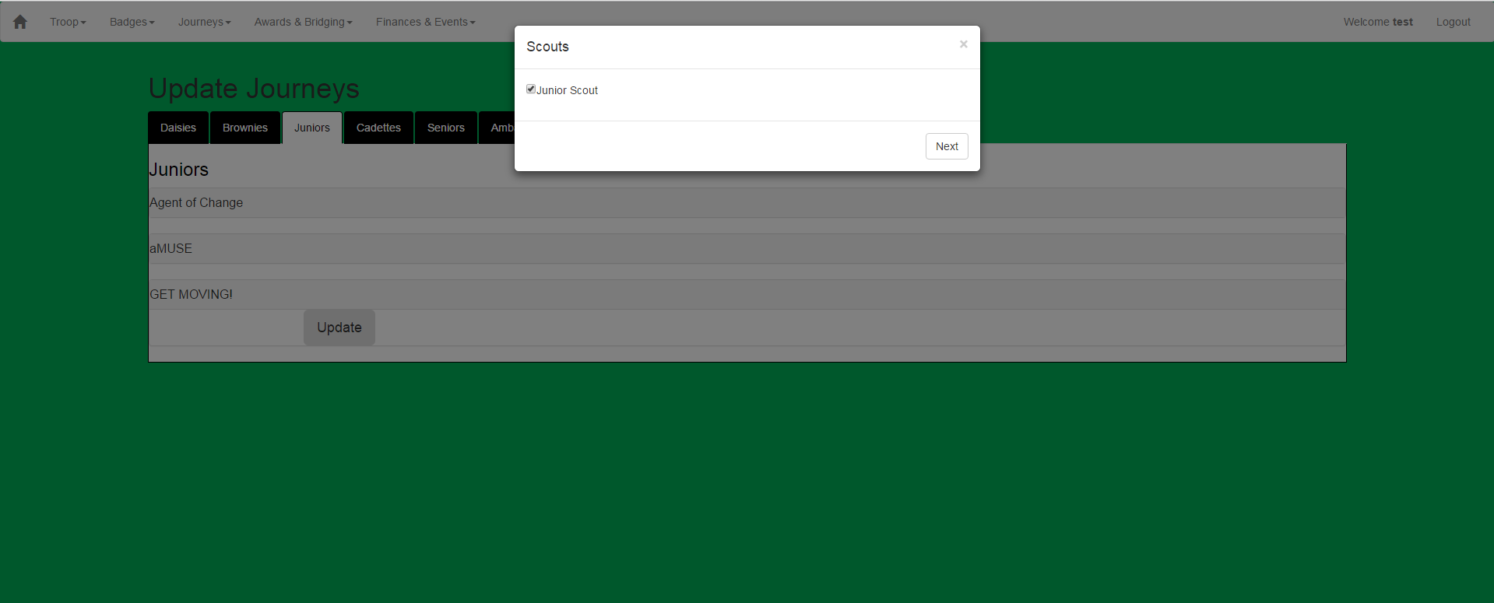
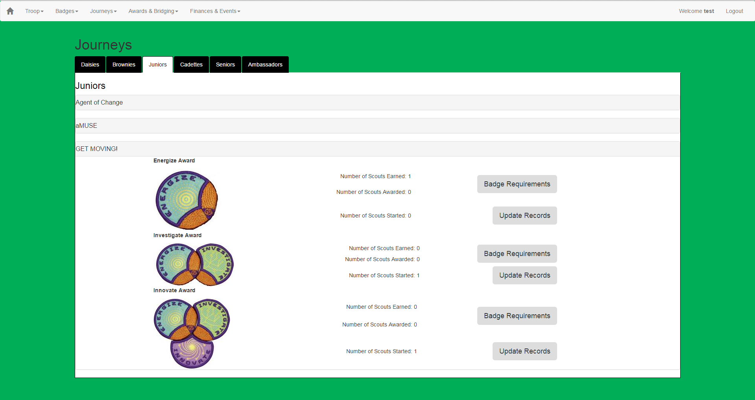

Slide 14
Post-mortem
Key take-aways:
Client Interactions can be difficult to schedule
Stick with a plan
Time estimations were incorrect
Should have stuck with what worked the first semester
Inconsistent work schedule

